Slide 1
Introduction to Mobile Application Development

Slide 2
Why Mobile ?
Now it is the trend.
Previously – Web , Now – Mobile
Big opportunities.
People working on the way.

Slide 3
Mobile Apps
A mobile application is software written for mobile devices that performs a specific task, such as a game, calendar, music player, etc.
Telco Apps – SMS based, USSD, WAP
Featured Mobile Phone Apps – J2me
Smart Phone Apps – Android, IOS, Windows Mobile, Blackbery

Slide 4
Mobile Apps : Business Perspective
Reaching to more users
▫ Growing number of smartphones
▫ Increasing affordability of smartphones
▫ Increasing mobile internet speed and quality
Catching users in more engaging way
Better sales conversion rate
Better collection of user’s contextual data
Ease of use : Better productivity
Around 70 per cent of rural users access the internet from their mobile handsets

Slide 5
Mobile Apps : User Perspective
Ease of use
One device works for everything
▫ Health
▫ Shopping
▫ Communication
▫ Entertainment
Low cost
Longer battery life
Relatively much easier learning curve

Slide 6
Mobile Apps : Developer Perspective
Multiple platforms
Different screen sizes
Screen density
User interaction
Limited hardware resources
Sensors
Integration with Phone Functions

Slide 7
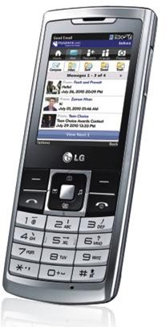
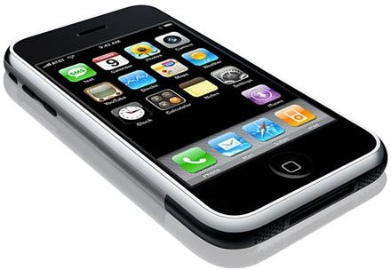
Smart Phones Getting More Popular
Mobile Phones
Featured Phones
Smart Mobile Phones

Slide 8


Slide 9
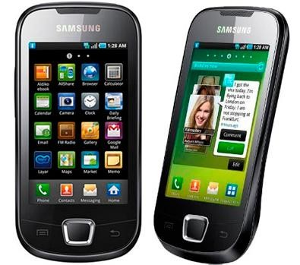

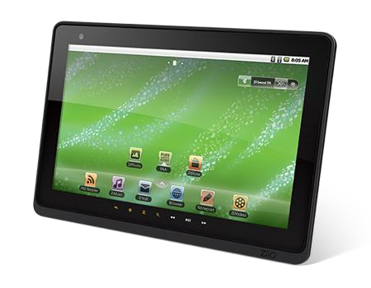
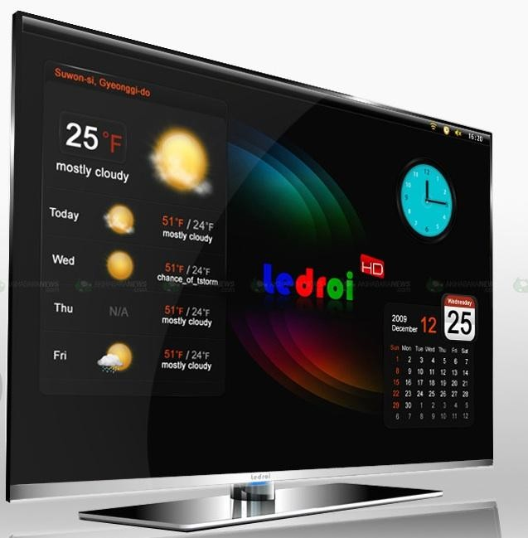
Android is Everywhere

Slide 10
Mobile Apps – 3 Types
Native - Programmed using Objective C on the iPhone or using Java on Android devices.
Hybrid - Mix between these two types of mobile applications.
Web Apps - Runs in the phone’s browser.

Slide 11
Native Apps
Android | Dalvik
IOS | Objective C
Windows Mobile 7 | XNA/Silverlight
Blackbery | Java
WebOS | HTML5

Slide 12

One Platform for All
HTML5=HTML, CSS, Java Scripts
HTML is Mobile
HTML is Capable
HTML is Open
It rocks on mobile devices

Slide 13
Android | Dalvik / HTML5
IOS | Objective C / HTML5
Windows Mobile 7 | XNA/Silverlight / HTML5
Blackbery | Java / HTML5
WebOS | HTML5

Slide 14
Still Native Apps Rock
Native apps make use of all the phone’s features, such as the mobile phone camera, geolocation, and the user’s address book.
Native apps do not need to be connected to the internet to be used.
A native app is specific to the mobile handset it is run on, since it uses the features of that specific handset.
Native apps can be distributed on the phone’s marketplace (e.g. Apple Store for iPhone or Ovi store for Nokia handsets or Android Market).

Slide 15
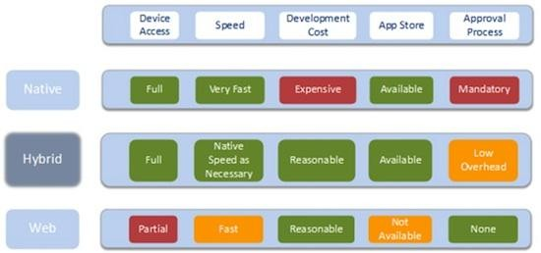
Overview

Slide 16
Thank You

